Slide 1

B. K. BIRLA COLLEGE OF ARTS, SCIENCE & COMMERCE (AUTONOMOUS), KALYAN
DEPARTMENT OF INFORMATION TECHNOLOGY
TWITTER DATA ANALYSIS :
Using Python
Presented By:
Kumari Shikha (Roll no.: 25)
Bhavana Sakat (Roll no.: 03)
Under Guidance of :
Prof Esmita Gupta
Vice-Principal, IT Dept.

Slide 2
ABSTRACT
Reviews act as a valuable source of information for decision making.
A huge amount of opinions are available publicly in the form of reviews.
To optimize the time-consuming task of analysing the data or reviews, there is a need for an automated system that provides the summarized result of user sentiments.
For our project, we have used twitter data as a source of information to analyse.
Thus, we will be showing you all how we built a system that gathers data from twitter and bundles it for us to run sentiment analysis on it.
Let’s Get Started

Slide 3
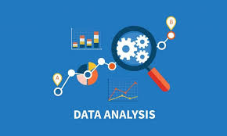
INTRODUCTION
WHAT IS DATA ANALYSIS?

Slide 4

……
Why Twitter Data?
Goldmine of Data
217 million monetizable daily active users on Twitter (Twitter, 2022).
Short text message of 140 characters
Users often discuss current affairs and share personal views.

Slide 5
OBJECTIVES
Running sentiment analysis on specific users, and the way they move with the world.
Running sentiment analysis on specific keyword and visualizing the sentiment

Slide 6
SYSTEM REQUIREMENTS
HARDWARES : (WE USED) | SOFTWARES:
PROCESSOR- INTEL CORE i5 | 1. OS: 64 bit Windows 11
2. RAM- 8 GB | 2. Programming Language: Python 3
3. Hard Disk- 1 TB | 3. Streamlit library
 | 4. Pycharm Compiler

Slide 7
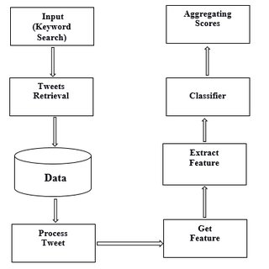
BASIC ARCHITECTURE:

Slide 8
MODULES:
1.Data Authentication
2. Data Collection
3. Data Preprocessing
4. Data Visualization

Slide 9
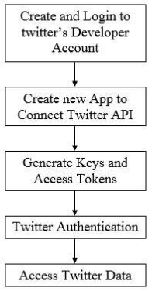
DATA AUTHENTICATION
In order to fetch tweets through Twitter API, one needs to register an App through their twitter account.
Once the app is created, you will be redirected to the app page.
Open the ‘Keys and Access Tokens’ tab.
Copy ‘Consumer Key’, ‘Consumer Secret’, ‘Access token’ and ‘Access Token Secret’.

Slide 10
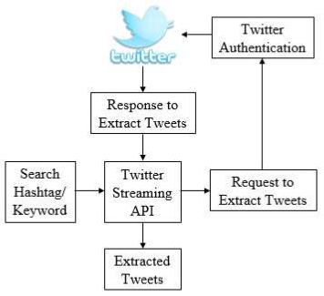
DATA COLLECTION
Real-time data collected from Twitter.
So, the code’s efficiency and accuracy depend upon the correctness and quality of data collected.
So the data should be clear as possible for better results.
Depending on the hashtag entered by the user we will get the most popular and recent tweets.

Slide 11
DATA PREPROCESSING:
Data collected from various means will be in an unorganized format and there may be a lot of null values, invalid data values, and unwanted data.
Cleaning all those data and replacing them with appropriate or approximate data and removing null and missing data and replacing them with some fixed alternate values are the basic steps in pre-processing of data.
Data must be kept in an organized format. So here we have used some expressions to clean data.

Slide 12
DATA VISUALIZATION:
The main goal of data visualization is to make it easier to identify patterns, trends and outliers in large data sets.
Data visualization is one of the steps of the data science process, which states that after data has been collected, processed and modeled, it must be visualized for conclusions to be made.
Data visualization is also an element of the broader data presentation architecture (DPA) discipline, which aims to identify, locate, manipulate, format and deliver data in the most efficient way possible.

Slide 13
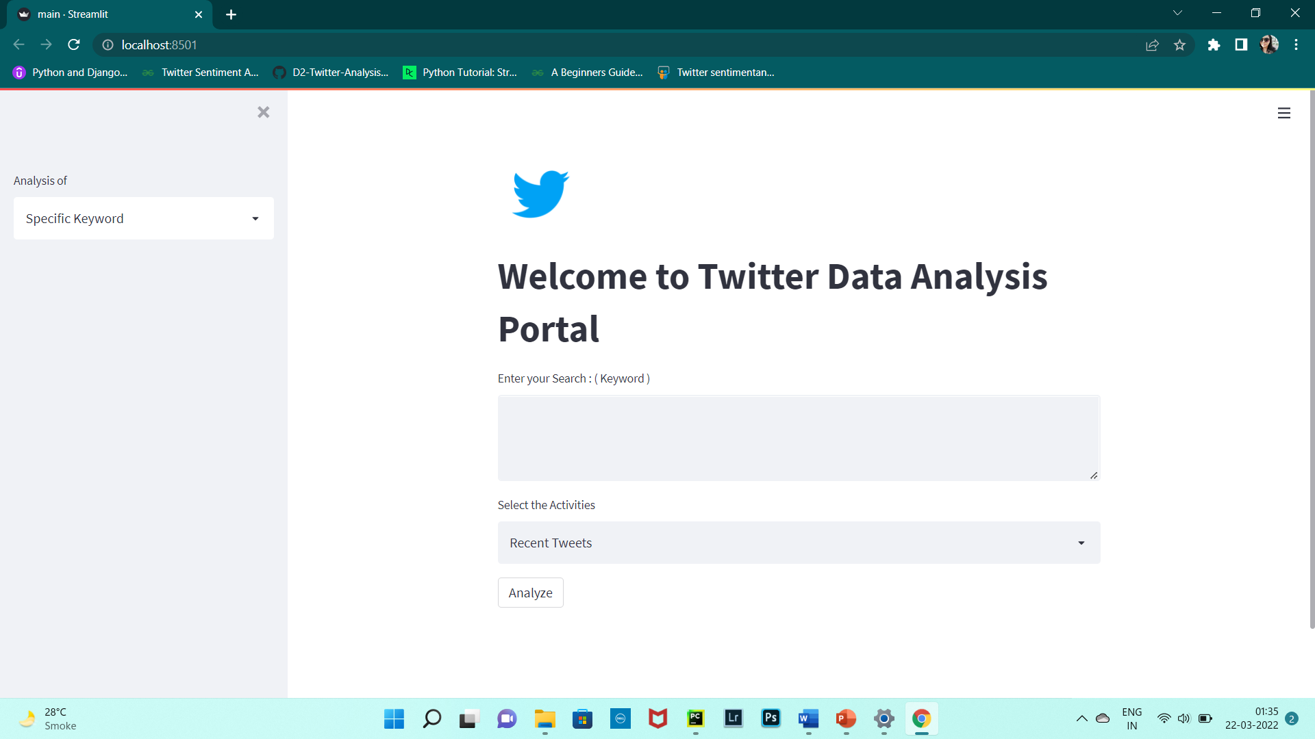
MAIN SCREEN

Slide 14
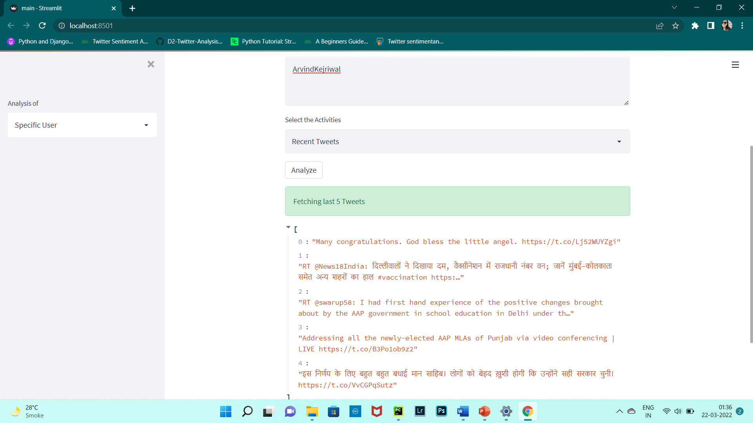
RECENT TWEETS OF A SPECIFIC USER

Slide 15
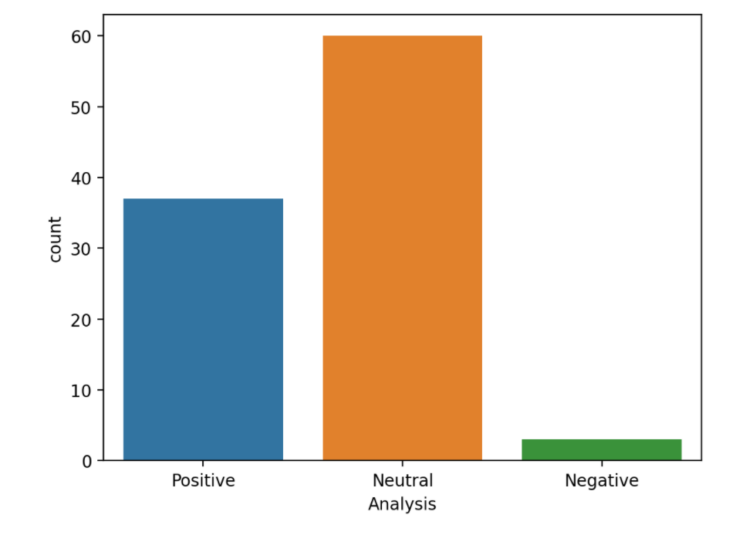
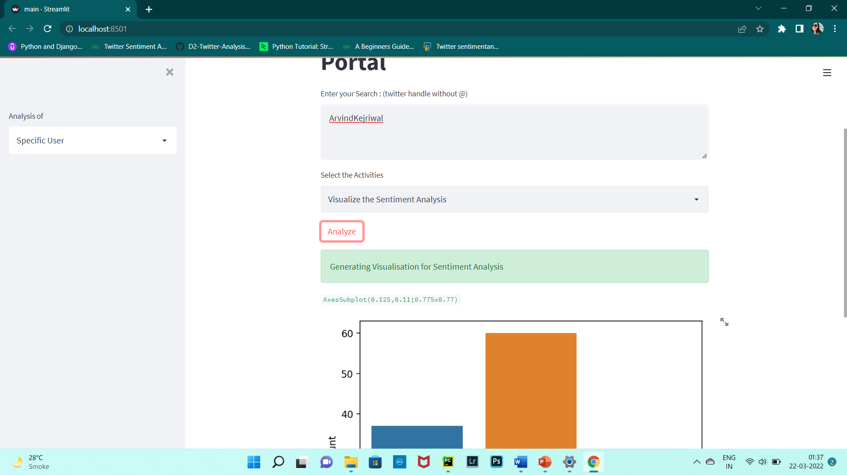
ANALYSIS OF A SPECIFIC USER

Slide 16
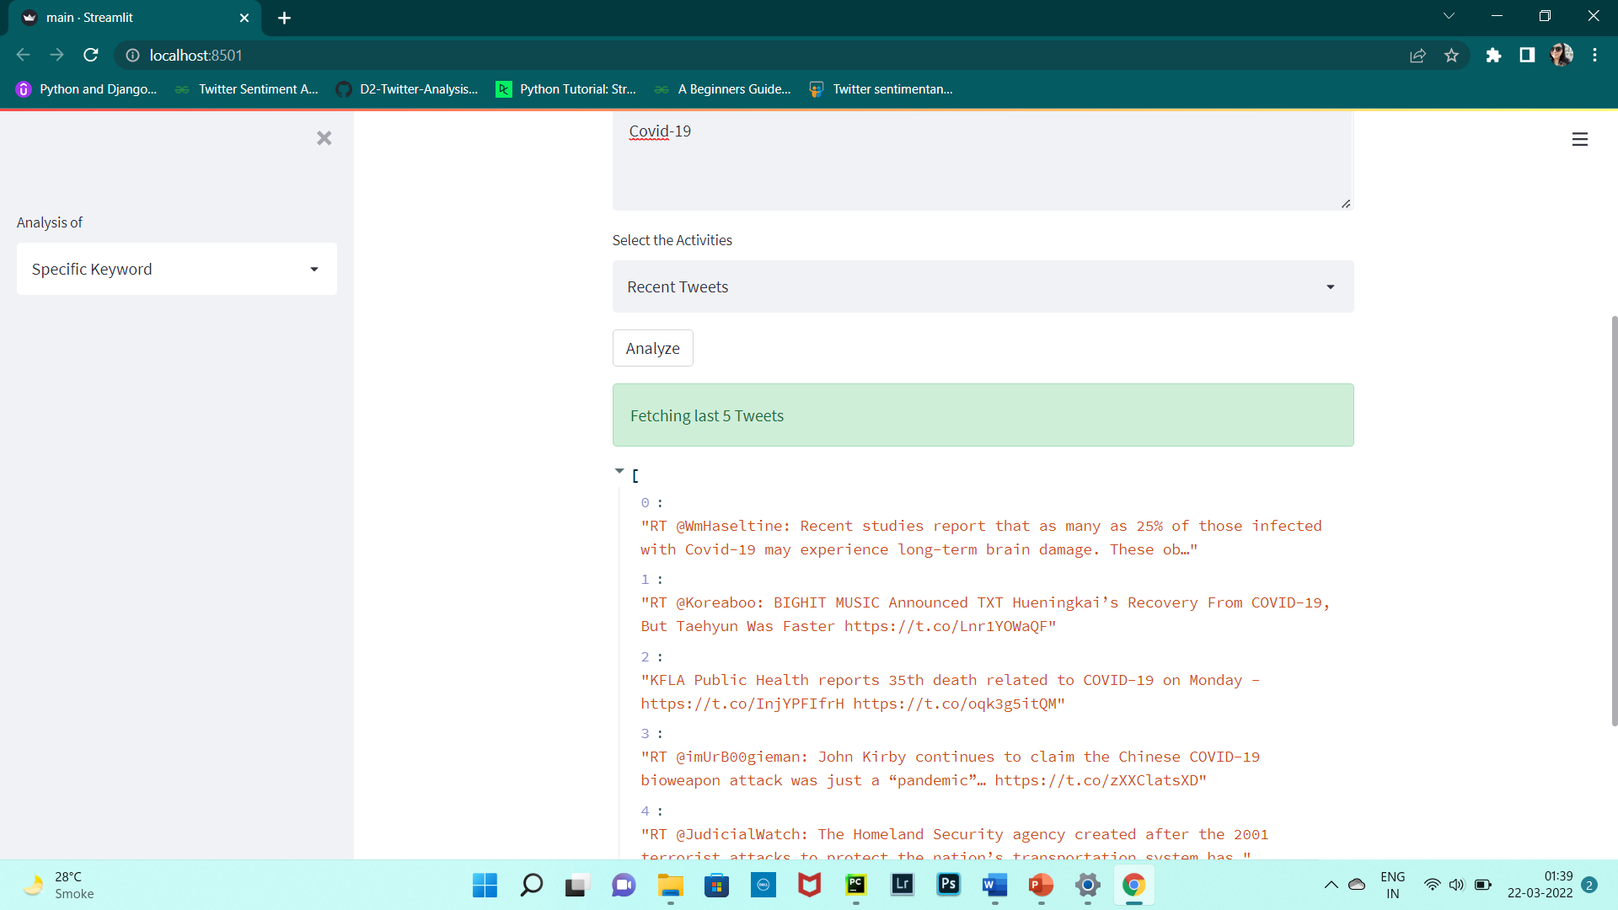
RECENT TWEETS BASED ON A SPECIFIC KEYWORD

Slide 17
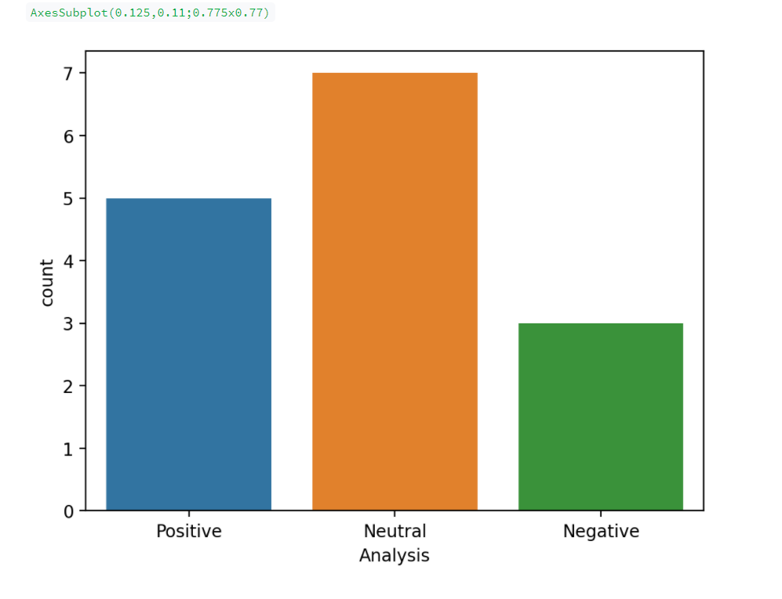
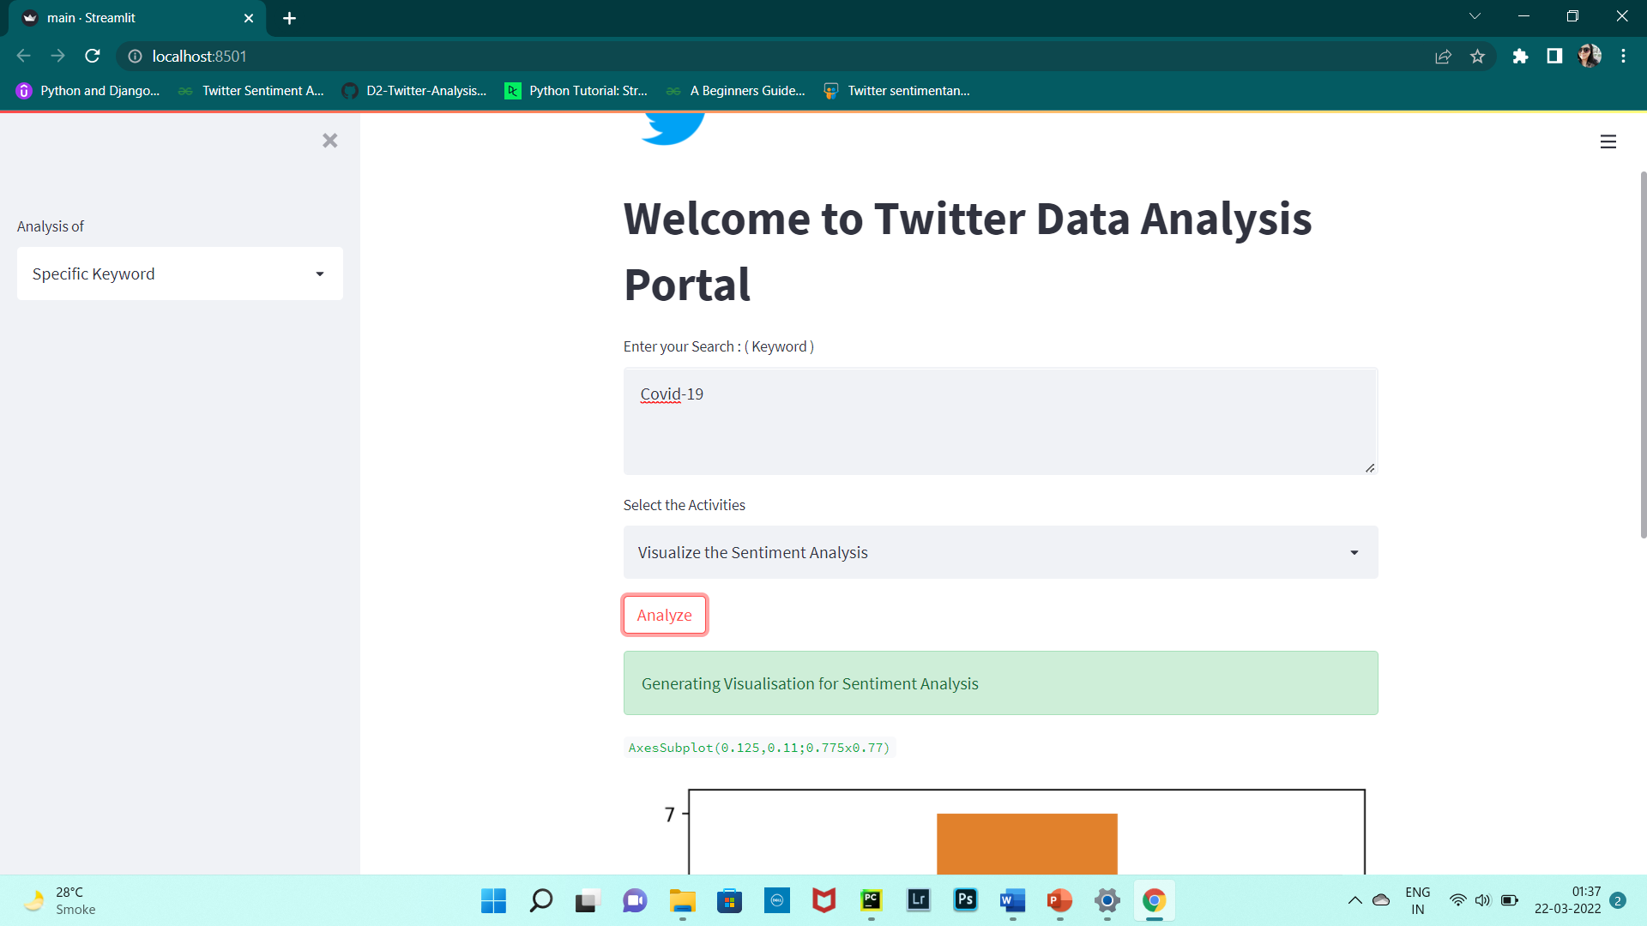
ANALYSIS OF TWEETS BASED ON A SPECIFIC KEYWORD

Slide 18


